Slide 1
Wheat Genotypic Performance Under Variable Nitrogen Fertilization: A Comparative Study Across Two Locations
Statistical Methods II (STAT 541)
Group: AAHS
Amool Singh Vadithya¹, Ashish Chaudhary¹, Horender Sharma¹, Shivam Singh²
¹Department of Agronomy, Horticulture, and Plant Science
²Department of Natural Resource Management
Instructor: Dr. Gemechis Djira
GTA: Mr. Iftekhar Chowdhury
South Dakota State University , Brookings, SD
December 12th, 2025

Slide 2
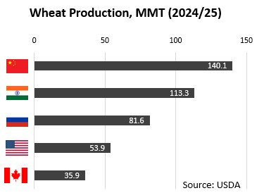
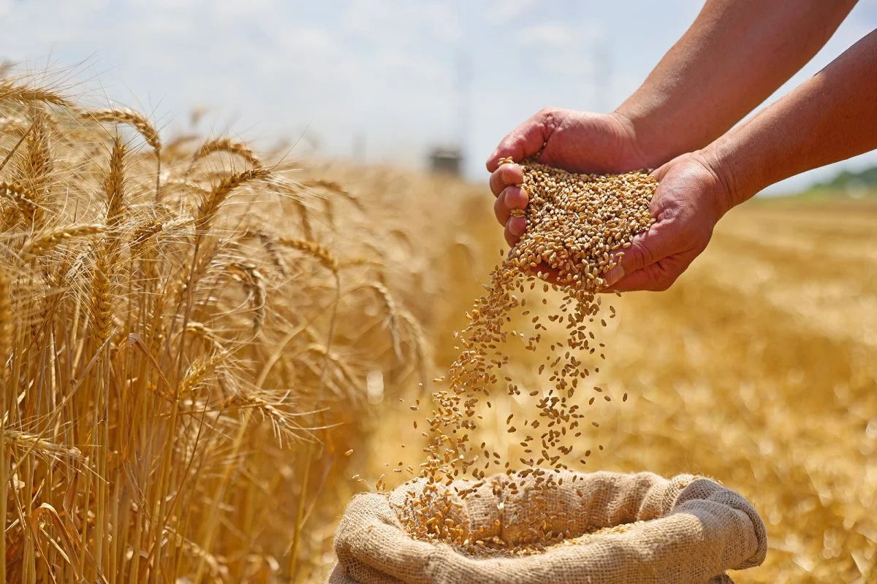
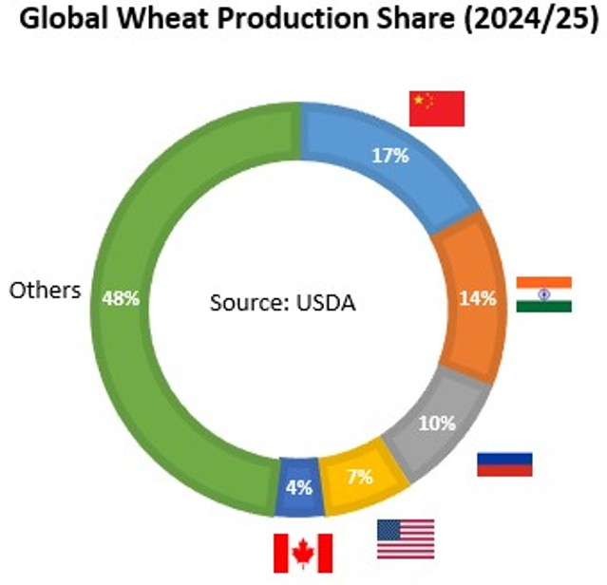
Introduction
Notes:
“Wheat is one of the most important crops in the world. It feeds billions of people and plays a major role in global food security.
The horizontal bar graph shows the top wheat-producing countries in 2024–25: which
China leads with about 140 million metric tons
Followed by India with 113 million
Russia 82 million
The United States is 4th with 54 million
And Canada produces about 36 million metric tons
The doughnut chart shows each country’s share of global wheat production.
China contributes 17%, India 14%, Russia 10%, the U.S. 7%, Canada 4%, and all other countries together make up 48%.
This shows the important of wheat is around the world, and the United States, despite ranking fourth, plays a very important role in global markets, breeding programs, and wheat exports.
By the way, in 2024, the US exported 40% of its wheat production, which was valued at approximately $6 billion.
All these numbers are given by the USDA.

Slide 3
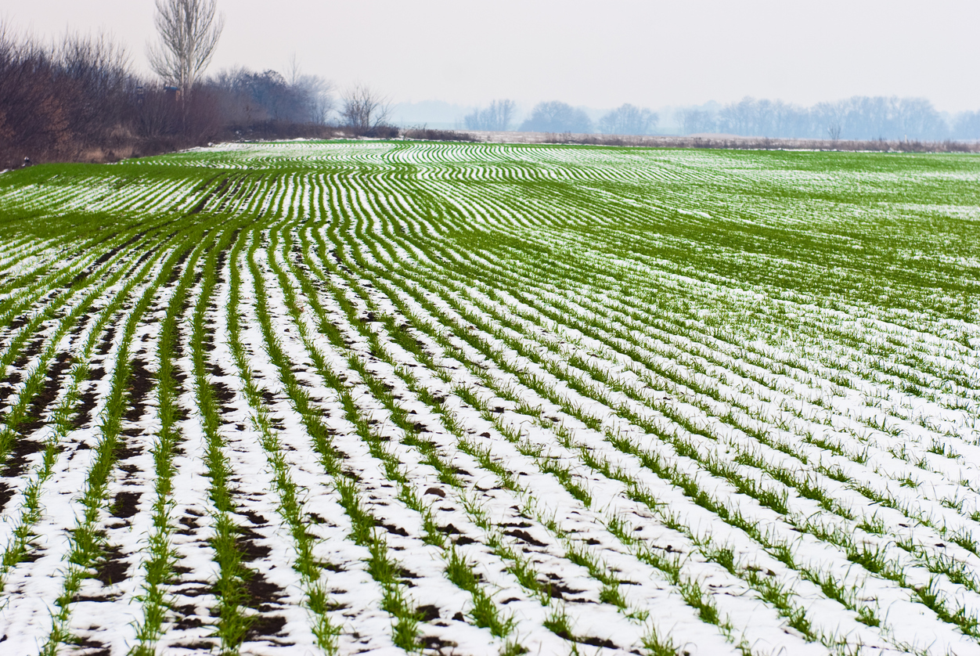

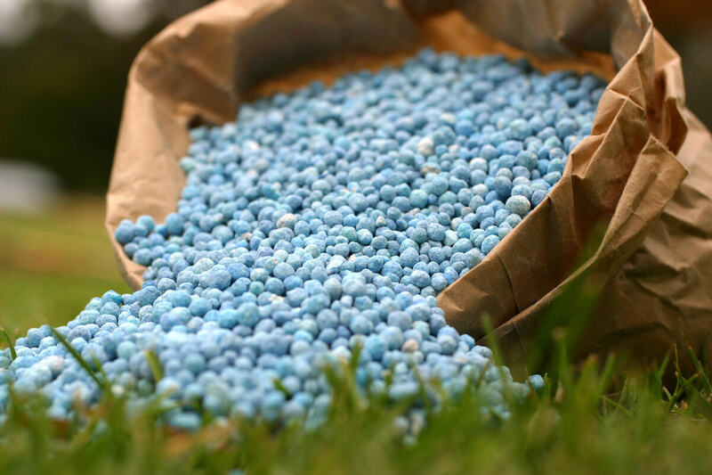

Introduction contd…
Genotype
Interaction
Winter Wheat
Wheat Calendar
Fertilizer
Environment
Fertilizer
Grain Yield
Grain Protein Content
Test Weight
Grain Nitrogen Content
Heading Weight
 | Jan | Feb | Mar | Apr | May | June | July | Aug | Sept | Oct | Nov | Dec
Winter Wheat
Spring Wheat
Fertilizer
Notes:
The top-left image is winter wheat growing in rows, with snow still visible between the plants. The ability to survive the winter is the most unique characteristic of winter wheat.
As the calendar indicates, winter wheat is planted in the fall, survives through winter, and continues growing in spring.
This gives it a longer growing season and often higher yields of 20 to 50% as compared with spring wheat.
On the other hand, spring wheat has a short growing period from April to September.
Nitrogen is important for winter wheat, but managing nitrogen has challenges.
Using too much nitrogen can cause environmental problems like nitrate leaching and greenhouse gas emissions.
However, using too little nitrogen reduces yield, causing economic loss
So, there is interaction between genotype, environment, and fertilizer; together, these influence the final traits like yield, grain protein content, test weight, grain nitrogen, and heading date.

Slide 4
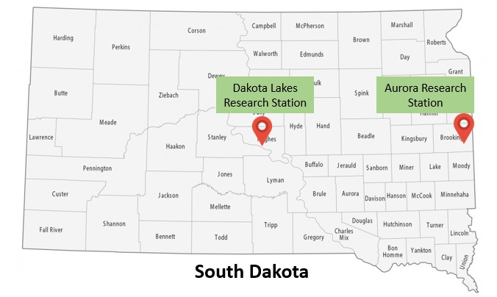

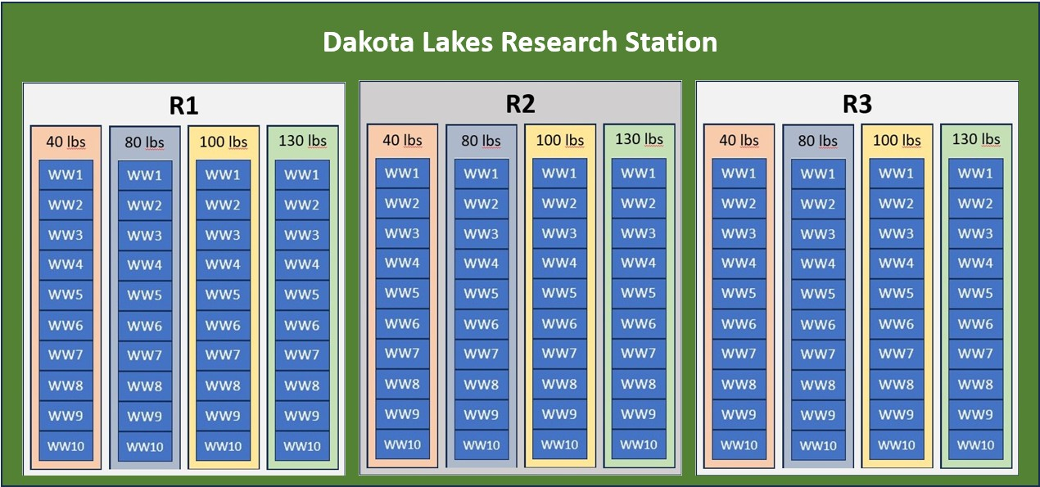
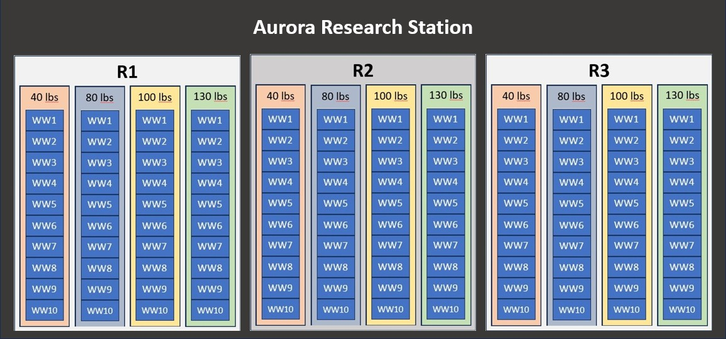
Research Site and Experimental Design
Genotypes → 10
Nitrogen doses → 4
Replications → 3
Environments → 2
Total Obs. → 240
Reference:
Location → Aurora
Genotypes → WW4
Nitrogen dose → 40 lbs
RCBD Split-plot design
Notes:
On the map of South Dakota, you can see two locations:
The Dakota Lakes Research Station,
And the Aurora Research Station.
These are the locations where the field experiments were conducted, representing two different environments
10 Wheat genotypes labelling WW1 to WW10 were tested. A genotype is simply a different wheat variety with its own genetic traits.
These genotypes were developed by the South Dakota State Winter Wheat Breeding Lab.
And, each genotype was tested under four nitrogen levels: 40, 80, 100, and 130 pounds per acre. Among them, 40 pounds was the control.
Each combination was replicated three times at both locations.
So, in total, we had 240 observations, giving us a strong dataset.
Even though the genotypes are in series, in the experiment, they were distributed randomly for a Randomized Complete Block Design with a split-plot design structure.

Slide 5
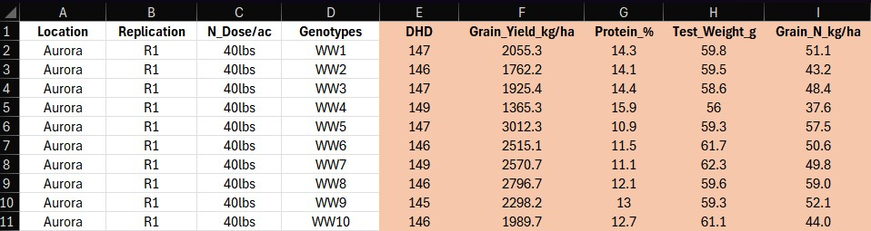
Objective and Hypothesis
Objective:
To identify and recommend the specific genotypes performing best under different nitrogen fertility levels and environmental conditions
Raw Data
Hypothesis:
H_{o}: Nitrogen, genotype, location, or their interactions have no significant effect on grain yield
H₁: These factors, or their interactions, have a statistically significant impact on grain yield
Notes:
The main objective of our study was to identify and recommend specific winter wheat genotypes that perform best under different nitrogen fertility levels and across the two environments
To guide our analysis, we developed the
The null hypothesis as Nitrogen level, genotype, location, or their interactions have no significant effect on the measured traits.
And the alternative hypothesis as, at least one of these factors, or their interactions, significantly affects traits
The raw data sample shows the dependent variables as heading date, grain yield, protein percentage, test weight, and grain nitrogen content, which were recorded during the experiment.
Again, all this data was generated by the Winter Wheat Breeding Lab.
Now, my group members will continue the rest of the presentations.

Slide 6
Descriptive Analyses
Table 1: Descriptive statistics for grain yield (kg/ha) data of 10 wheat genotypes
Table 2: Descriptive statistics for grain yield (kg/ha) data of 10 wheat genotypes under four different nitrogen rates
Location | Genotypes | Mean | SD | CV % | Minimum | Maximum | Median
Aurora | WW1 | 2211.56 | 664.98 | 30.07 | 1041.68 | 3293.12 | 2273.08
Aurora | WW2 | 2237.07 | 688.59 | 30.78 | 1117.67 | 3190.21 | 2257.29
Aurora | WW3 | 2256.90 | 757.02 | 33.54 | 925.26 | 3121.24 | 2514.45
Aurora | WW4 | 2015.32 | 549.02 | 27.24 | 1169.54 | 2892.84 | 2194.79
Aurora | WW5 | 2624.75 | 555.73 | 21.17 | 1844.98 | 3570.02 | 2638.75
Aurora | WW6 | 2629.62 | 317.69 | 12.08 | 2104.33 | 3084.79 | 2623.09
Aurora | WW7 | 2712.79 | 438.67 | 16.17 | 1690.80 | 3438.76 | 2717.14
Aurora | WW8 | 2423.49 | 409.82 | 16.91 | 1762.15 | 2984.74 | 2439.25
Aurora | WW9 | 2301.43 | 417.13 | 18.12 | 1690.26 | 2989.37 | 2201.43
Aurora | WW10 | 2540.76 | 295.51 | 11.63 | 1989.72 | 3089.59 | 2568.22
Dakota Lakes | WW1 | 2616.56 | 372.30 | 14.23 | 2221.10 | 3647.41 | 2528.93
Dakota Lakes | WW2 | 2436.56 | 337.92 | 13.87 | 1781.96 | 3082.27 | 2487.31
Dakota Lakes | WW3 | 2621.93 | 291.49 | 11.12 | 2204.39 | 3082.55 | 2664.41
Dakota Lakes | WW4 | 2471.39 | 359.40 | 14.54 | 1740.69 | 3023.78 | 2472.92
Dakota Lakes | WW5 | 2456.19 | 300.07 | 12.22 | 2019.22 | 2971.61 | 2403.24
Dakota Lakes | WW6 | 2696.54 | 367.51 | 13.63 | 1799.39 | 3072.34 | 2808.30
Dakota Lakes | WW7 | 2604.55 | 300.02 | 11.52 | 2077.44 | 3005.00 | 2676.156088
Dakota Lakes | WW8 | 2352.55 | 310.48 | 13.20 | 1739.31 | 2638.82 | 2490.825116
Dakota Lakes | WW9 | 2353.67 | 414.32 | 17.60 | 1654.07 | 3001.83 | 2445.445068
Dakota Lakes | WW10 | 2551.32 | 271.78 | 10.65 | 2164.07 | 2919.61 | 2552.850195
Location | N_Dose | Mean | SD | CV % | Minimum | Maximum | Median
Aurora | 40lbs | 2424.38 | 453.93 | 18.72 | 1365.30 | 3293.12 | 2440.79
Aurora | 80lbs | 2406.26 | 566.11 | 23.53 | 1169.54 | 3438.76 | 2564.56
Aurora | 100lbs | 2397.16 | 601.79 | 25.10 | 1041.68 | 3570.02 | 2359.45
Aurora | 130lbs | 2353.69 | 608.28 | 25.84 | 925.26 | 3108.74 | 2408.27
Dakota Lakes | 40lbs | 2527.75 | 410.13 | 16.22 | 1707.16 | 3647.41 | 2558.89
Dakota Lakes | 80lbs | 2491.15 | 279.55 | 11.22 | 1814.10 | 2963.21 | 2534.02
Dakota Lakes | 100lbs | 2592.47 | 312.38 | 12.05 | 1654.07 | 3082.55 | 2625.96
Dakota Lakes | 130lbs | 2453.13 | 352.75 | 14.38 | 1739.31 | 3072.34 | 2460.92
At Aurora, the top genotypes were WW7, WW6, and WW5.
At Dakota Lakes, the top were WW6, WW1, and WW7.
WW7 and WW6 performed consistently well in both locations.
At Aurora, the lowest nitrogen dose—40 lbs—produced the highest yield, and higher nitrogen decreased yield.
At Dakota Lakes, 100 lbs gave the highest yield, but all doses performed similarly.

Slide 7
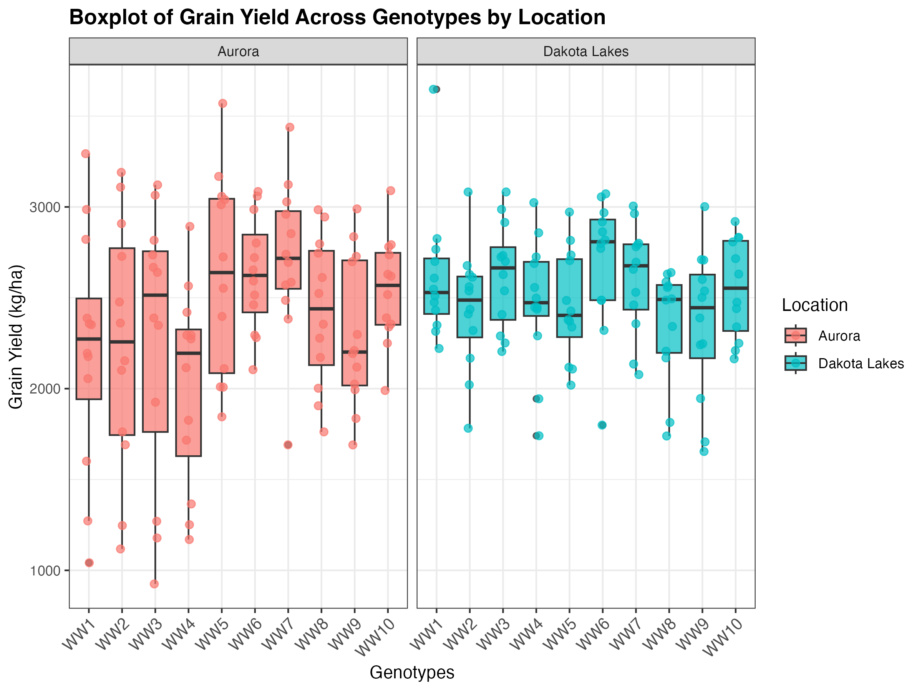
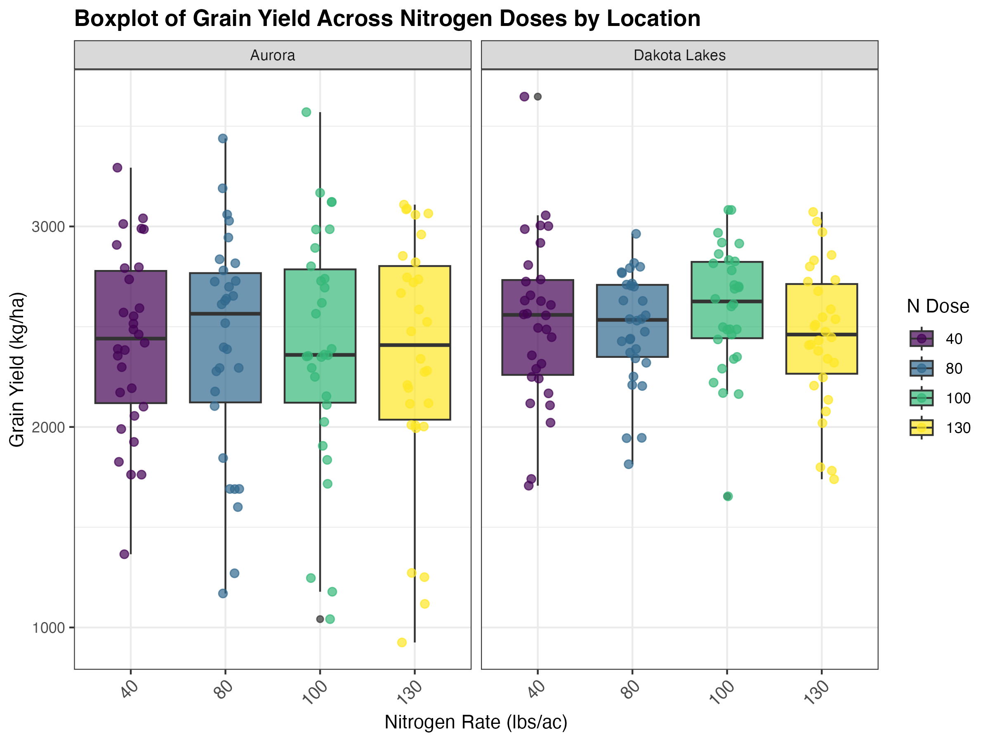
Box plots

Slide 8
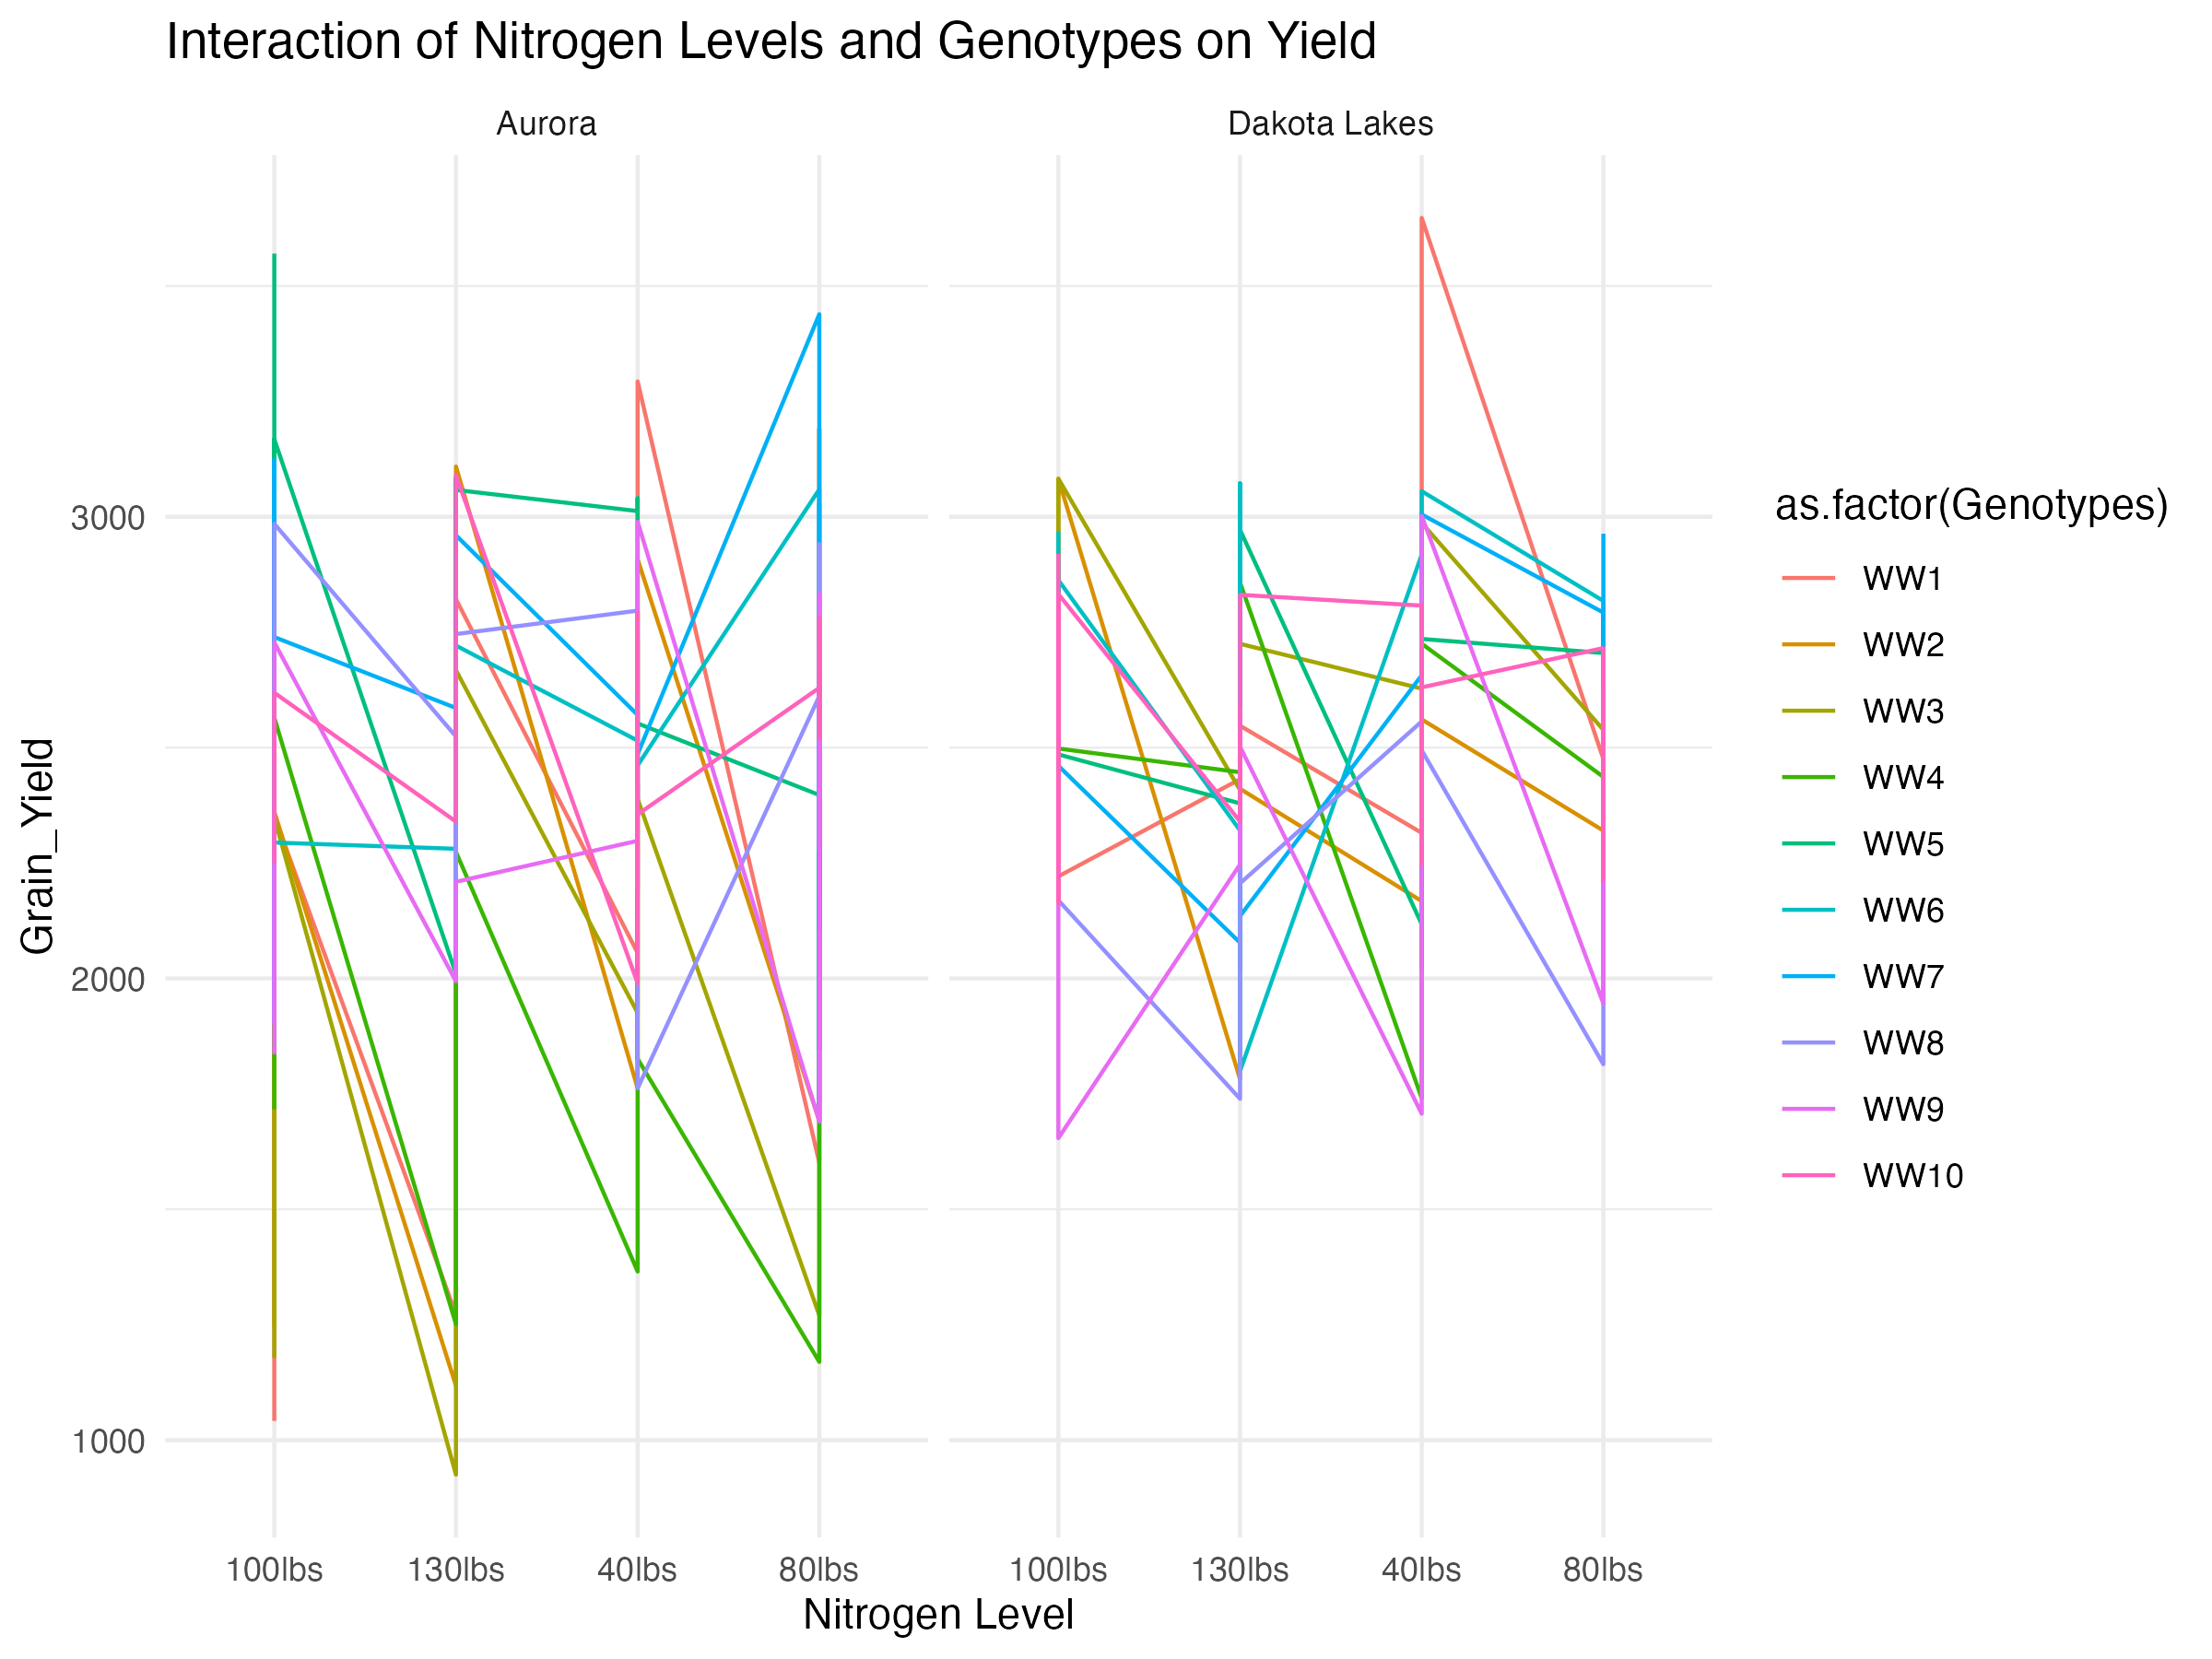
Interaction plots
Some variation, but WW7 stable

Slide 9
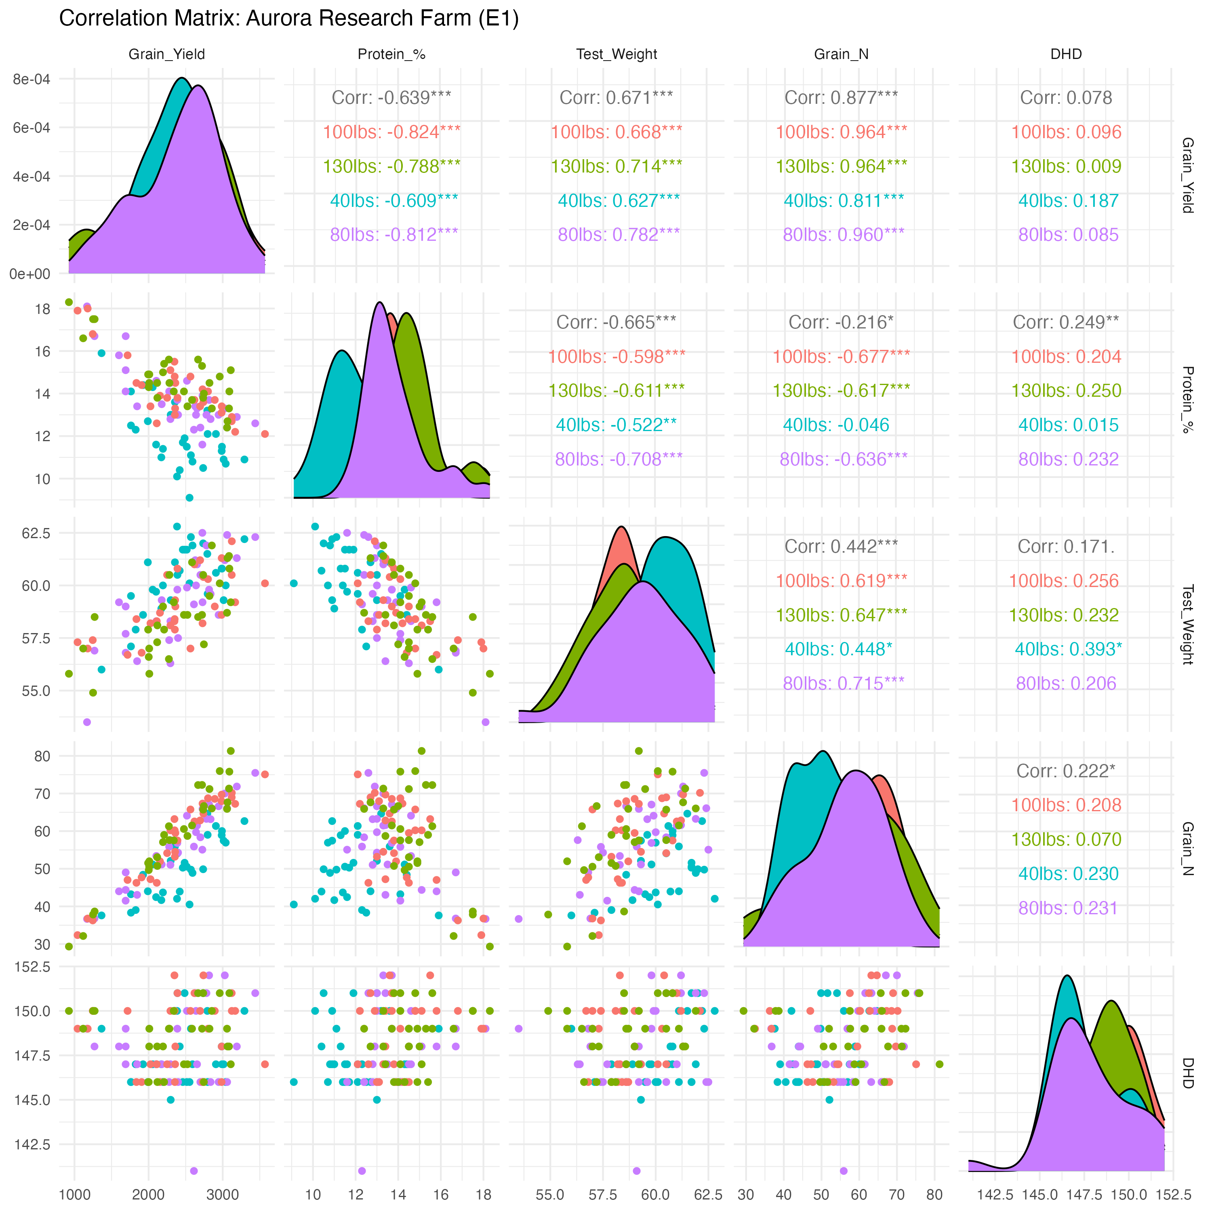
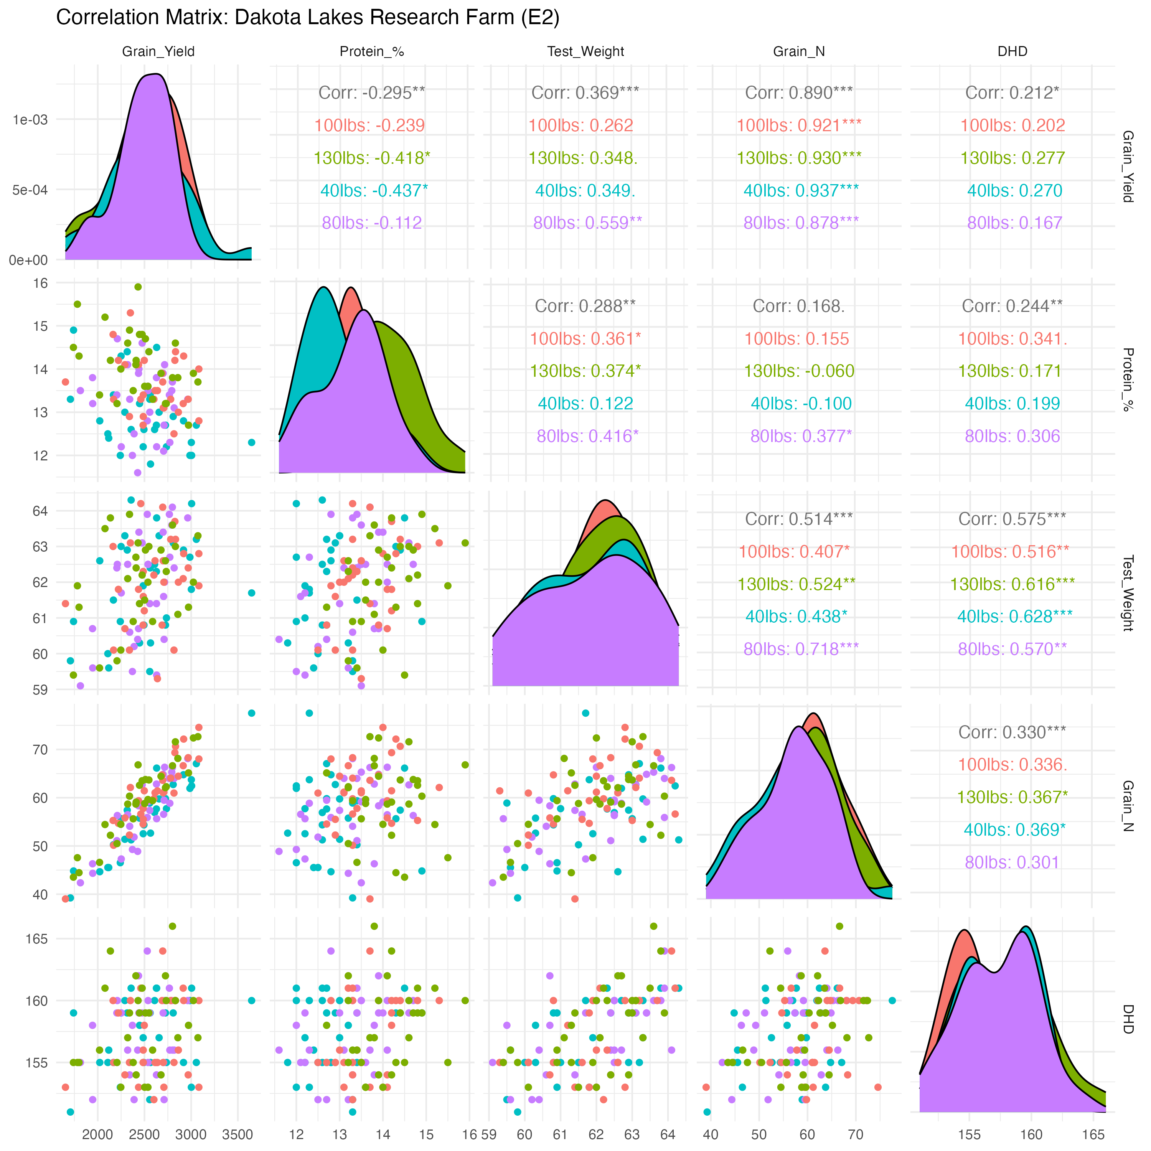
Correlation plots
Yield ↓ when protein ↑
Yield ↑ when grain nitrogen ↑
Test weight had a + ve effect
Heading date- No association

Slide 10
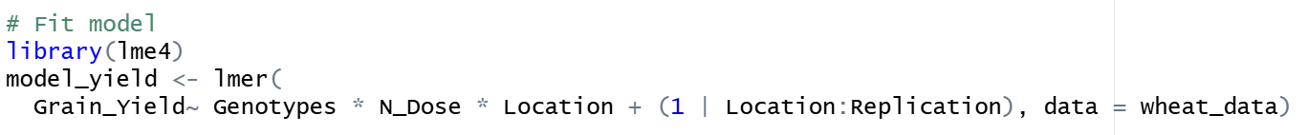
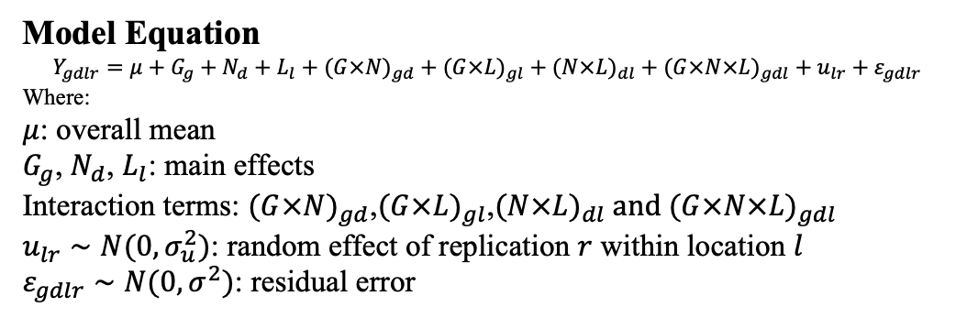
Methodology Statement
We employed a Linear Mixed Model (LMM) using the lme4 package in R to evaluate the specific interactive effects of genetics and management practices on grain yield.
Fixed effect: Genotypes, Nitrogen Dose, and Location : to enable direct mean comparisons and to assess the stability of specific genotypes across the varying nitrogen levels and the two distinct environments.
Random effect: Replications nested within locations - this structure effectively partitioned the variance attributed to spatial field heterogeneity from the residual error, thereby increasing the statistical power to detect significant differences among the fixed factors.
Model Equation
$$Y_{gdlr}=μ+G_{g}+N_{d}+L_{l}+(G×N)_{gd}+(G×L)_{gl}+(N×L)_{dl}+(G×N×L)_{gdl}+u_{lr}+ε_{gdlr}$$
Where:
$μ$: overall mean
$G_{g}$, $N_{d}$, $L_{l}$: main effects
Interaction terms: $(G×N)_{gd}$,$(G×L)_{gl}$,$(N×L)_{dl} and (G×N×L)_{gdl}$
$u_{lr}∼N(0,σ_{u}^{2})$: random effect of replication $r$ within location $l$
$ε_{gdlr}∼N(0,σ^{2})$: residual error

Slide 11
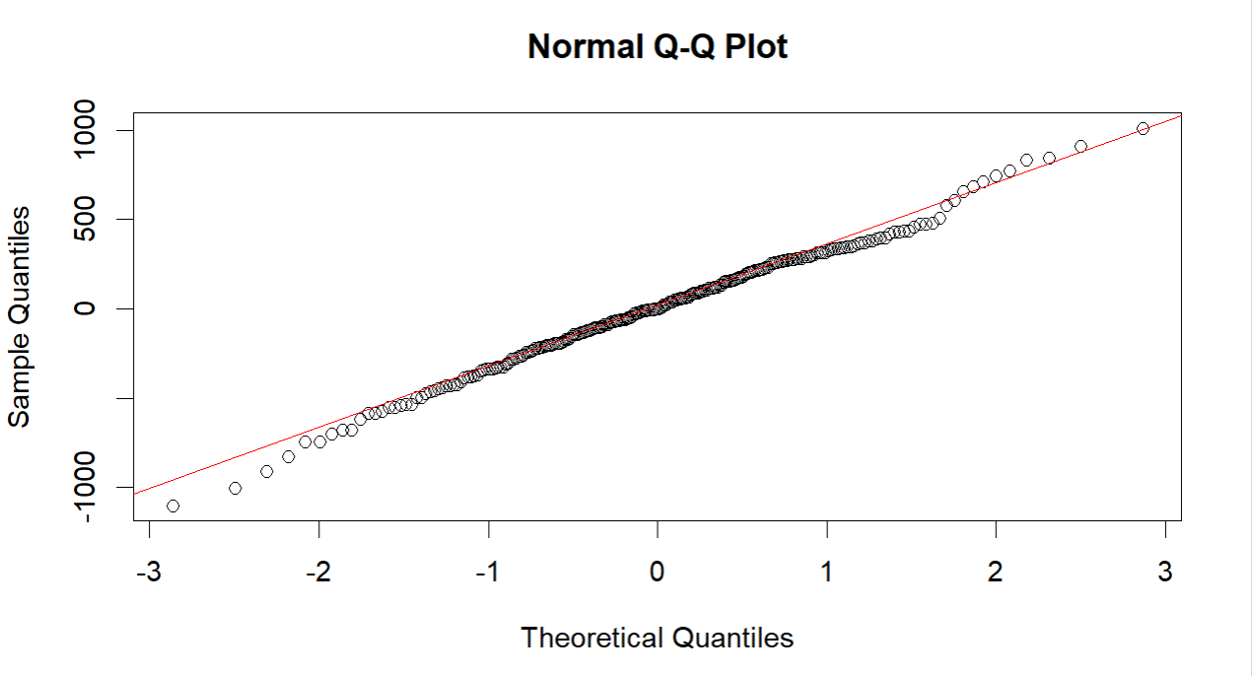
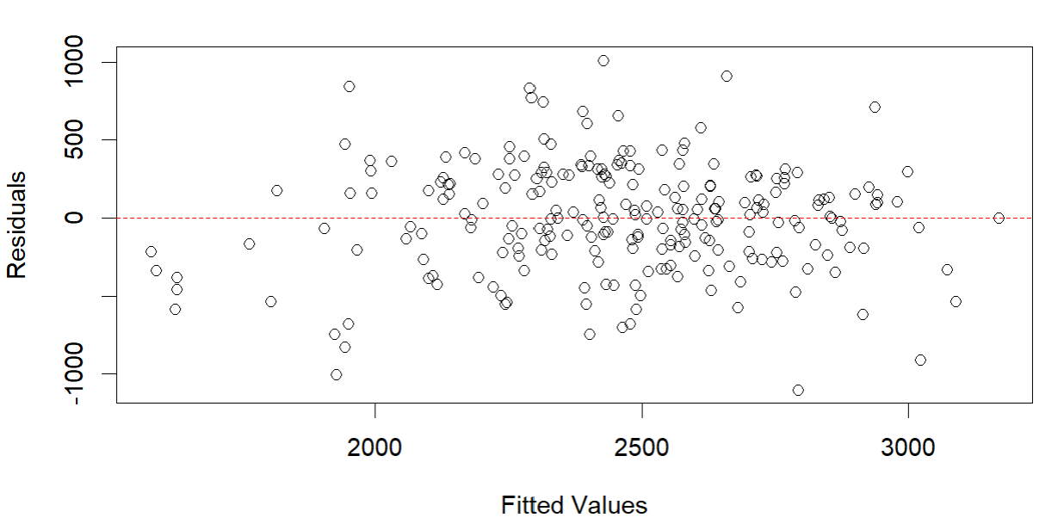
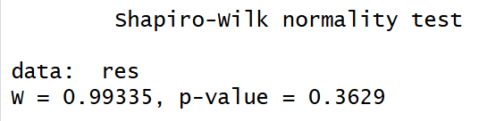
Model Fitting and Assumptions
The assumptions of normality is checked for the residuals by using:
Residual vs fitted plots, Q-Q plot and Shapiro-Wilk test
This confirms that the residuals follow a normal distribution, validating the use of the linear mixed model.

Slide 12
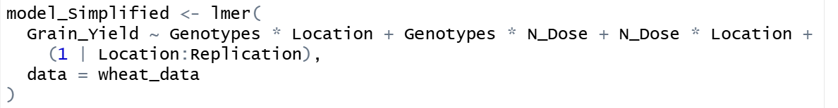
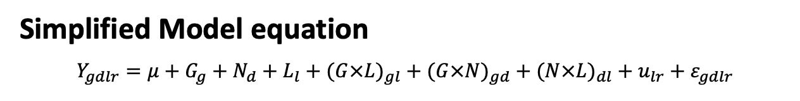
Multicollinearity
Variables | GVIF | DF | GVIF^(1/(2*Df))
Genotypes | 1.342177e+08 | 9 | 2.828427
N_Dose | 8.000000e+03 | 3 | 4.472136
Location | 4.891005e+00 | 1 | 2.211562
Genotypes:N_Dose | 1.143492e+16 | 27 | 1.983237
Genotypes:Location | 1.944764e+08 | 9 | 2.887305
N_Dose:Location | 9.197232e+03 | 3 | 4.577302
Genotypes:N_Dose:Location | 1.261965e+16 | 27 | 1.986861
The interaction term between Genotypes:N_Dose:Location had a high GVIF, which might be problematic. Upon further inspection, we decided to remove this interaction term as well, as it was causing multicollinearity and affecting model stability.
Simplified Model equation
$$Y_{gdlr}=μ+G_{g}+N_{d}+L_{l}+(G×L)_{gl}+(G×N)_{gd}+(N×L)_{dl}+u_{lr}+ε_{gdlr}$$
After removing Genotypes:N_Dose:Location, the variance inflation factor (VIF) analysis for the final model indicates low to moderate multicollinearity among predictors. Most of the terms exhibit GVIF^(1/(2·Df)) values around 2, suggesting minimal collinearity.
Variables | GVIF | DF | GVIF^(1/(2*Df))
Genotypes | 1.953125e+06 | 9 | 2.236068
N_Dose | 2.150607 | 3 | 4.472136
Location | 1.331000e+03 | 1 | 2.211562
Genotypes:N_Dose | 7.329165e+02 | 27 | 1.983237
Genotypes:Location | 8.519680e+07 | 9 | 2.887305
N_Dose:Location | 9.150607 | 3 | 4.577302

Slide 13
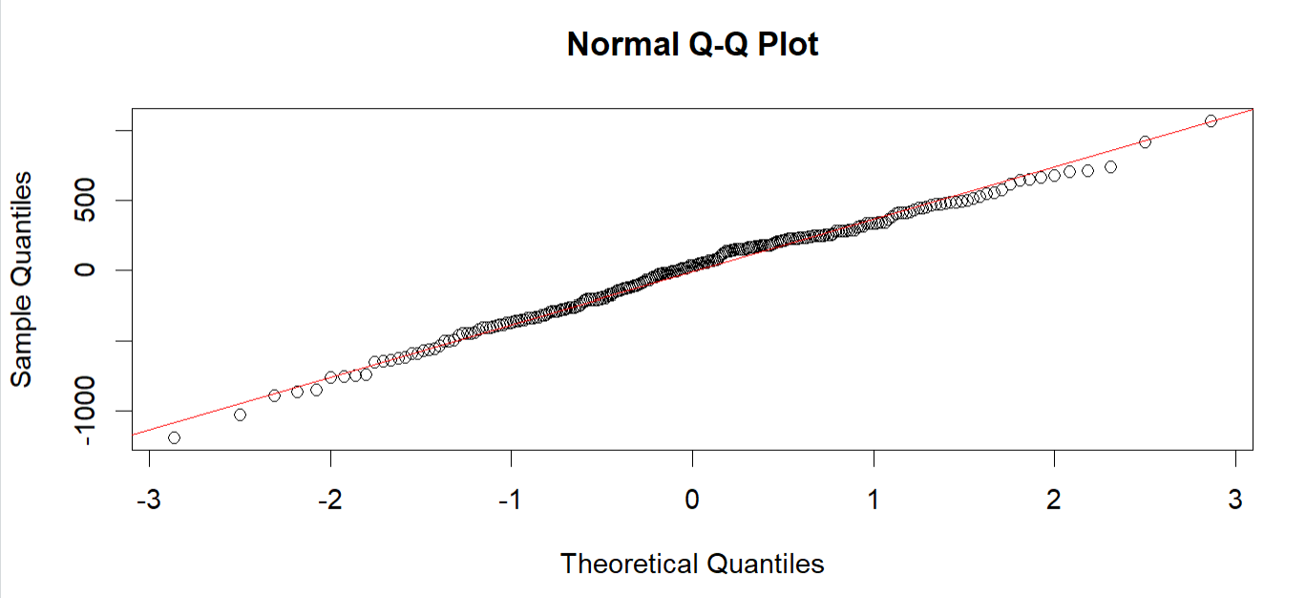
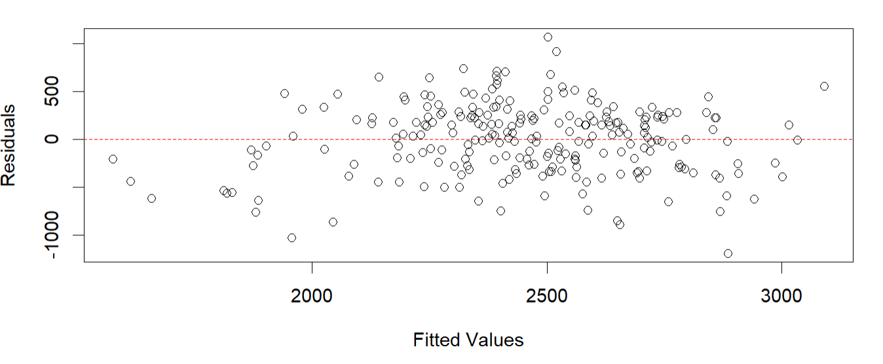
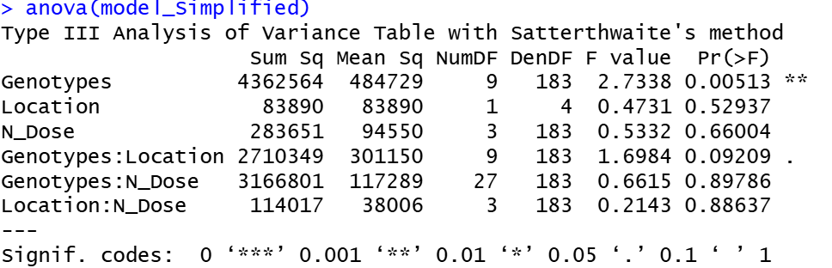
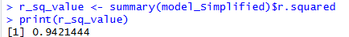
Residual Vs fitted plot and Q-Q plot for checking model assumptions.

Slide 14
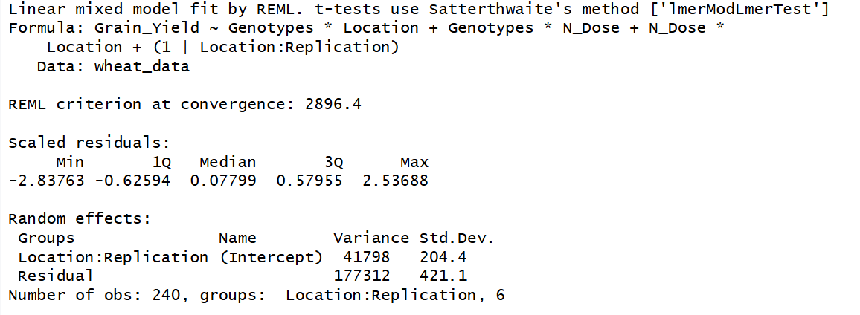
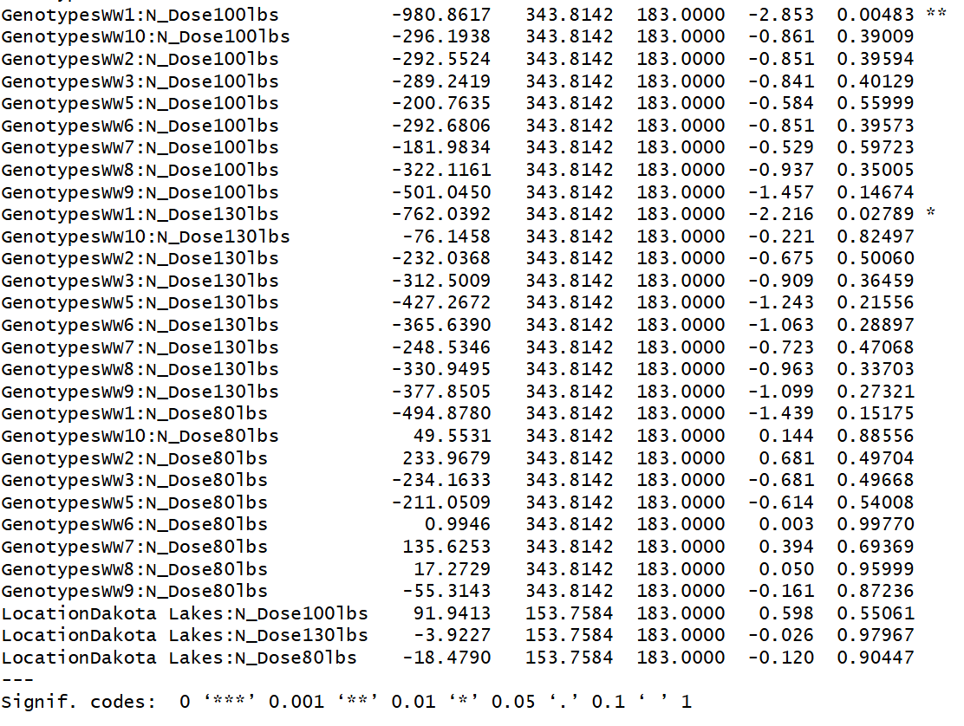
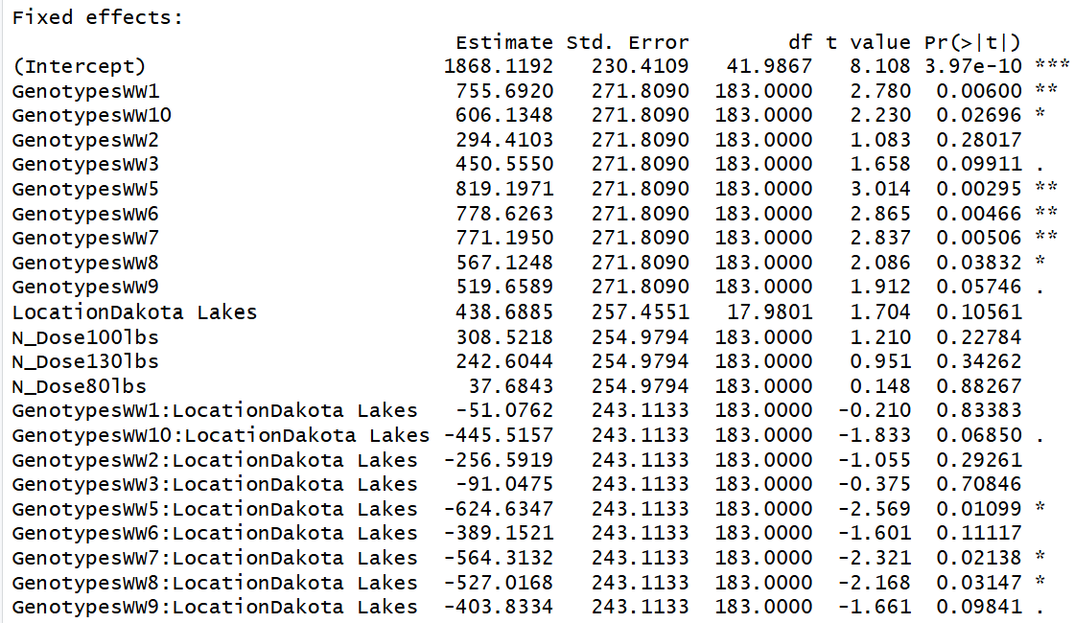

Slide 15
Main Effects:
1. Genotypes
High Performers: Genotypes WW5, WW6, and WW7 are the top performers. They show highly significant positive estimates as compared to the control WW4 genotype.
2. Location (Dakota Lakes):
On average, Dakota Lakes does not produce significantly higher yields than the Aurora location.
3.Nitrogen Dose:
Surprisingly, none of the Nitrogen doses (100, 130, 80 lbs) show a significant main effect (p > 0.05).
This suggests that simply adding more nitrogen (relative to the baseline) did not universally increase yield across all genotypes and locations.
Interaction Effects
1.Genotype x Location (GxE):
Several genotypes (WW5, WW7, WW8) have significant negative interactions at Dakota Lakes.
The WW5 is a superior variety in Aurora but at Dakota Lakes it loses most of that yield advantage.
2. Genotype x Nitrogen (GxN):
GenotypesWW1:N_Dose100lbs is showing significantly negative significant negative interactions
Genotype WW1 responds poorly to the 100lbs dose compared to the WW4 genotype. It might be sensitive to specific nitrogen levels or failed to utilize the input efficiently.
Interaction Effects

Slide 16
Conclusions and Recommendations
Descriptive Analysis
Statistical Analysis
The integrated descriptive analysis shows that genotype is the main visible driver of yield variation, with WW7—and to a slightly lesser extent WW6—consistently ranking among the highest-yielding and most stable lines across both Aurora and Dakota Lakes, as indicated by high mean yields, low CV values, and top median yields in boxplots.
Trait-wise, correlations highlight key physiological trade-offs: a strong positive association between grain N and yield, a clear and increasingly negative yield–protein relationship at higher N doses, and moderate positive links between yield and test weight, while heading date exhibits negligible influence on yield.
Location- and dose-wise trends suggest that N response is context dependent, with an unexpected yield decline beyond 40 lbs N/ac at Aurora but a modest yield peak around 100 lbs N/ac at Dakota Lakes, and interaction plots showing non-parallel lines across genotypes and N levels that visually hint at genotype-specific N use efficiency even where formal tests are non-significant.
Select Genotypes Carefully: Genotypes WW5, WW6, and WW7 are the clear leaders in yield potential at Aurora but their success is conditional.
Location Constraints: Do not expect the top performing varieties (WW5, WW7) to carry their full advantage to Dakota Lakes. Their performance is unstable across environments .
Nitrogen Inefficiency: There is no statistical evidence that increasing Nitrogen dose (80, 100, or 130 lbs) provides a general yield benefit in this dataset.

Slide 17
Future Research Priorities
01
02
03
Expanded Validation
N-Response Physiology
Yield-Protein Trade-off
Test WW6 and WW7 across broader environmental conditions and production systems other than Dakota lakes to confirm adaptability.
Specific Genotypes like WW1 showed negative response to increasing nitrogen dose. Dissect underlying mechanisms of nitrogen use efficiency differences.
Address the negative correlation to develop varieties combining high productivity with end-use quality.
Final Recommendation:
Future work should prioritize validating WW6 and WW7 in expanded environments, dissecting their N-response physiology, and addressing the yield–protein trade-off to develop varieties that combine high productivity with end-use quality. For now, these genotypes represent promising candidates for breeding programs.

Slide 18


